Slide 1
The User Interface
Session 4
Course : Mobile Community Solution
Effective Period : September 2016

Slide 2
Learning Objectives
At the end of this meeting is expected that students will be able to:
  Describe the main features of Android Programming and Android Software Development
  Produce simple Mobile Application using the main features of Android

Slide 3
Learning Objectives
At the end of this meeting is expected that students will be able to:
  Describe the main features of Android Programming and Android Software Development
  Produce simple Mobile Application using the main features of Android

Slide 4

Contents
RelativeLayout
LinearLayout
GridLayout

Slide 5
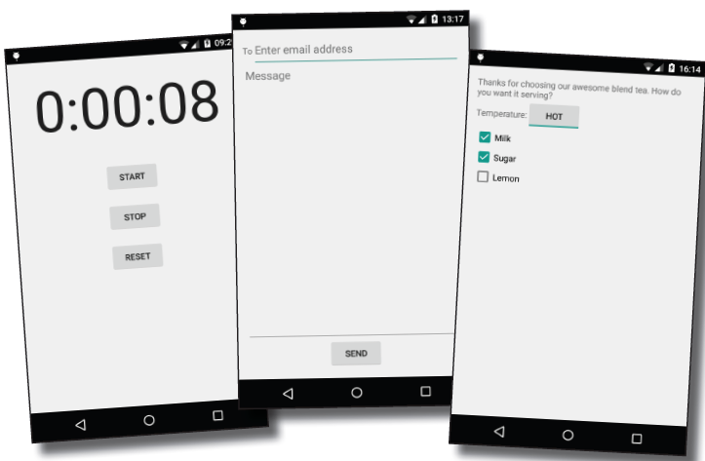
Your user interface is made up of layouts and GUI components
As you already know, a layout defines what a screen looks like, and you define it using XML.
Layouts usually contain GUI components such as buttons and text fields. Your user interacts with these to make your app do something.

Slide 6
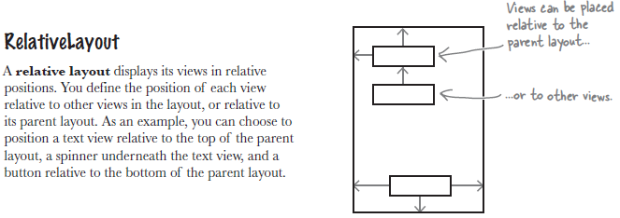
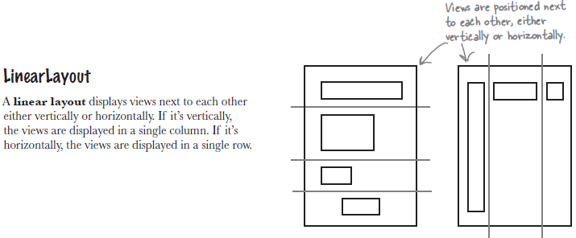
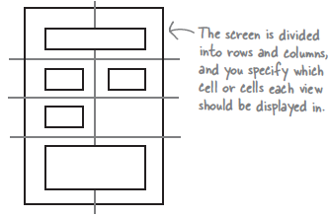
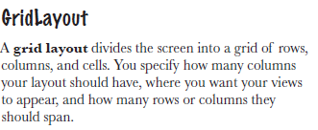
Three Key Layouts

Slide 7
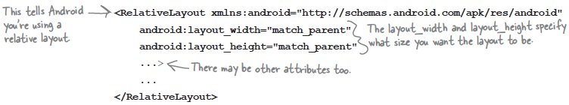
RelativeLayout
You define a relative layout using the <RelativeLayout> element like this:
The android:layout_width and android:layout_height attributes specify how wide and high you want the layout to be. These attributes are mandatory for all types of layout and view.
  “wrap_content” means that you want the layout to be just big enough to hold all of the views inside it.
  "match_parent" means that you want the layout to be as big as its parent—in this case, as big as the device screen minus any padding.
  "fill_parent" was used in older versions of Android, and it's now replaced by "match_parent"

Slide 8
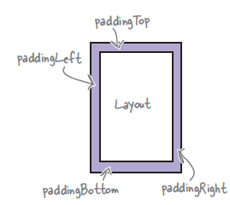
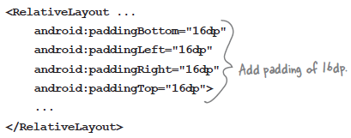
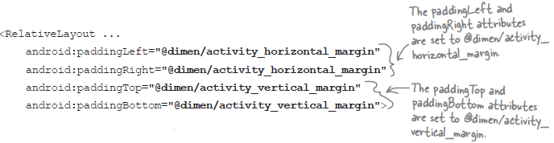
RelativeLayout
Adding Padding
If you want there to be a bit of space around the edge of the layout, you can set padding attributes.
An alternative approach is to specify the padding in a dimension resource file instead. Using a dimension resource file makes it easier to maintain the padding of all the layouts in your app.

Slide 9

RelativeLayout
Adding Padding (Cont.)
Android then looks up the values of the attributes at runtime in the dimension resource file. This file is located in the app/src/main/res/values folder, and it’s usually called dimens.xml:

Slide 10
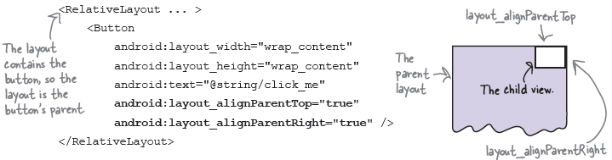
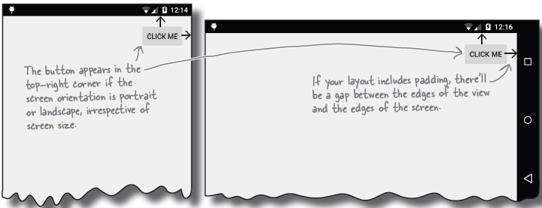
RelativeLayout
Positioning Views relative to the parent Layout
If you want a view to always appear in a particular position on the screen, irrespective of the screen size or orientation, you need to position the view relative to its parent.

Slide 11
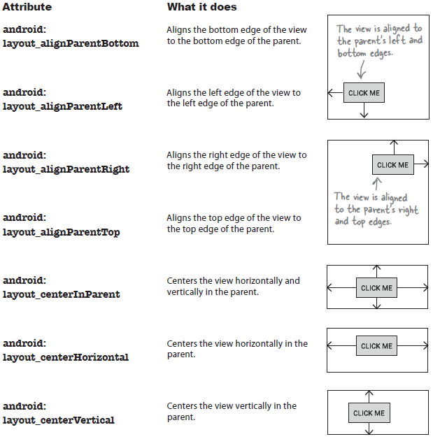
RelativeLayout
Attributes for positioning views relative to the parent layout

Slide 12

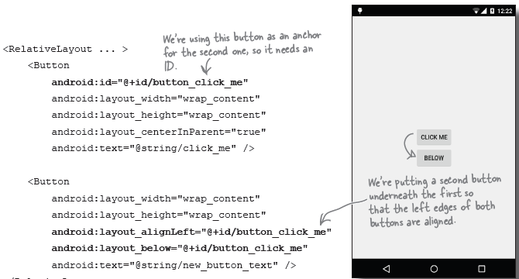
RelativeLayout
Positioning Views relative to the other views
In order to position a view relative to another view, the view you’re using as an anchor must be given an ID using the android:id attribute:
Here’s how you create a layout with two buttons:

Slide 13
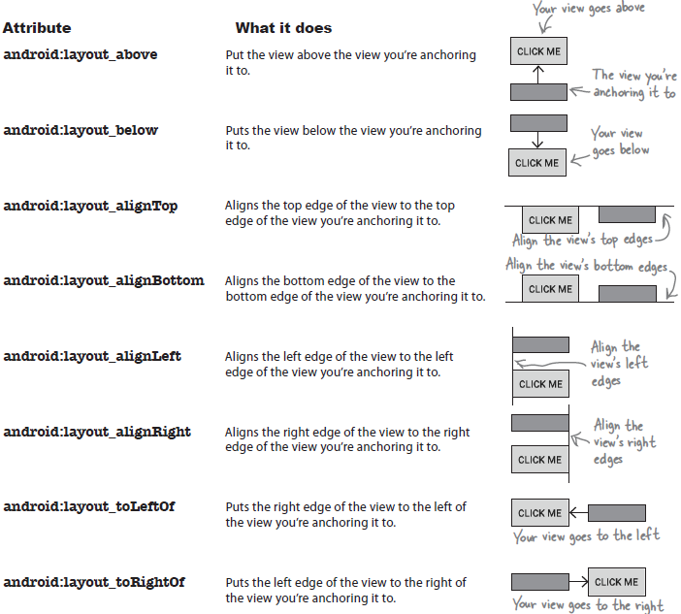
RelativeLayout
Attributes for positioning views relative to other views

Slide 14
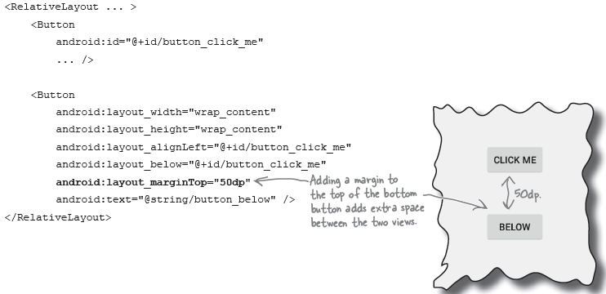
RelativeLayout
Use Margins to add distance between views
When you use any of the layout attributes to position a view, the layout doesn’t leave much of a gap. You can increase the size of the gap between views by adding one or more margins to the view.

Slide 15
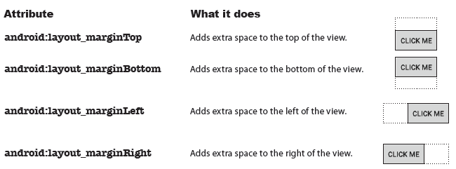
RelativeLayout
List of Margins to add distance between views

Slide 16
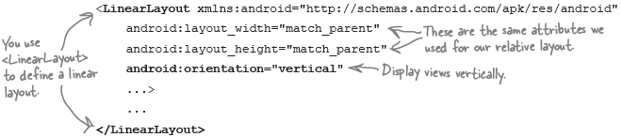
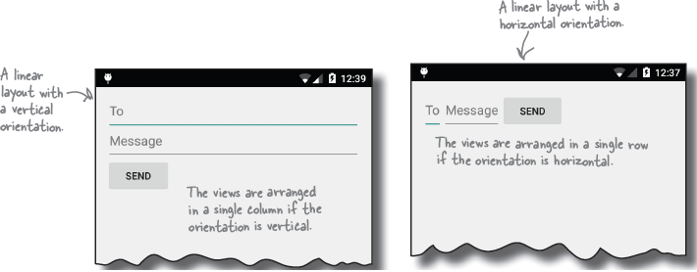
Linear Layout
You define a linear layout using the <LinearLayout> element like this:
android:layout_width and android:layout_height specify the layout width and height, just as it does with the relative layout. You use the android:orientation attribute to specify which direction you want to arrange views in.

Slide 17
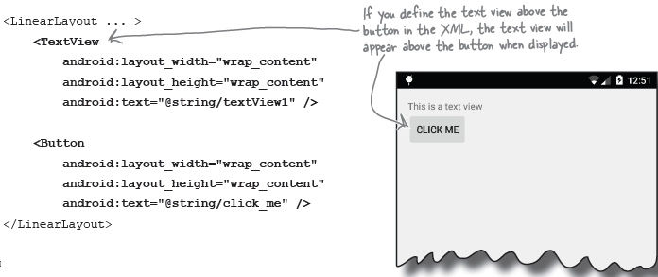
Linear Layout
A linear layout displays views in the order they appear in the layout XML
When you define a linear layout, you add views to the layout in the order in which you want them to appear.

Slide 18
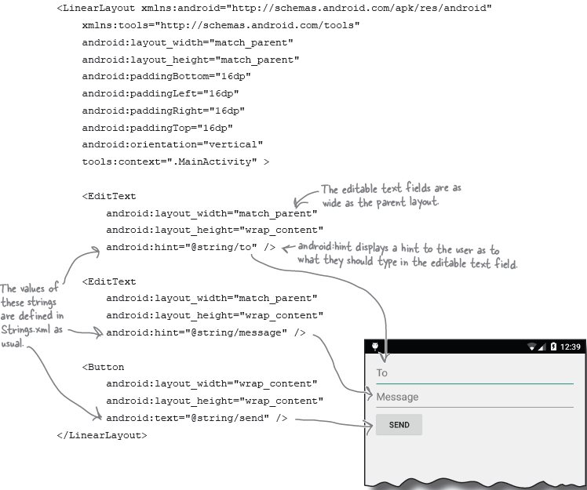
Linear Layout

Slide 19
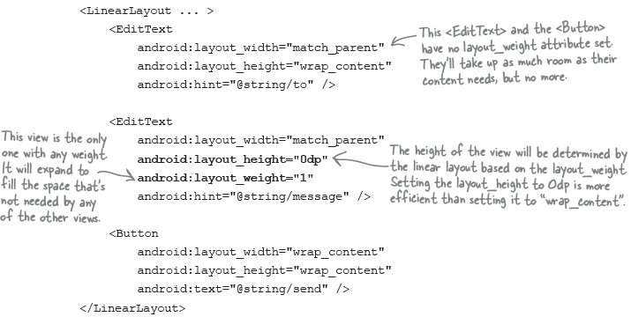
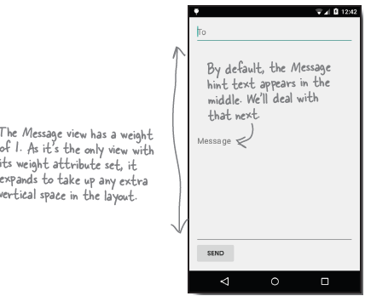
Linear Layout
Adding weight to one view
You assign weight to a view using: android:layout_weight=“number”

Slide 20
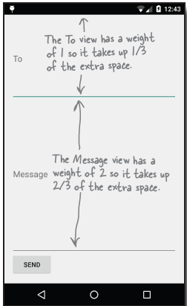
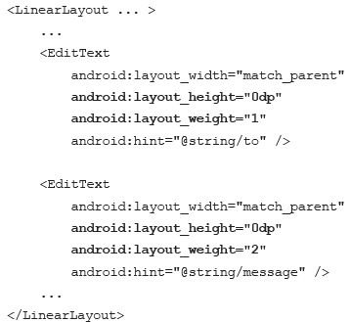
Linear Layout
Adding weight to multiple views
Suppose we gave the To text field a weight of 1, and the Message text field a weight of 2 like this:
Start by adding together the layout_weight attributes for each view. In our case, this is 1+2=3. The To view has a weight of 1, so this means it will take up 1/3 of the remaining space in the layout. The Message view has a weight of 2, so it will take up 2/3 of the remaining space.

Slide 21
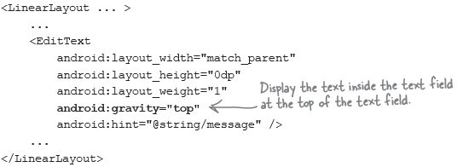
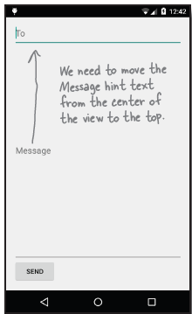
Linear Layout
Use Gravity to specify where text appear in text
The android:gravity attribute lets you specify how you want to position the contents of a view inside the view.
If you want the text inside a view to appear at the top, the following code will do the trick: android:gravity=“top”

Slide 22
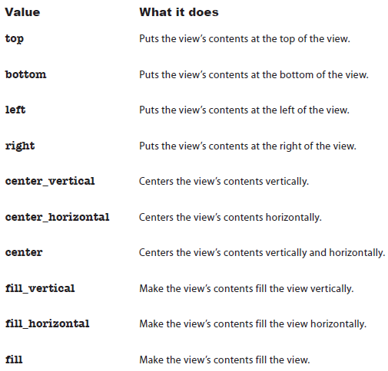
Linear Layout
List of android:gravity attribute

Slide 23
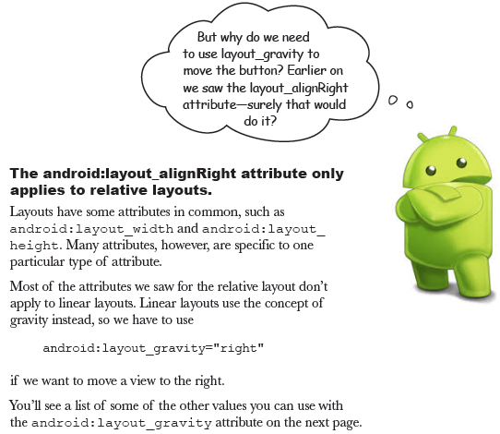
Linear Layout
Move the button with layout_gravity
The android:layout_gravity attribute lets you specify where you want a view in a linear layout to appear in its enclosing space.

Slide 24
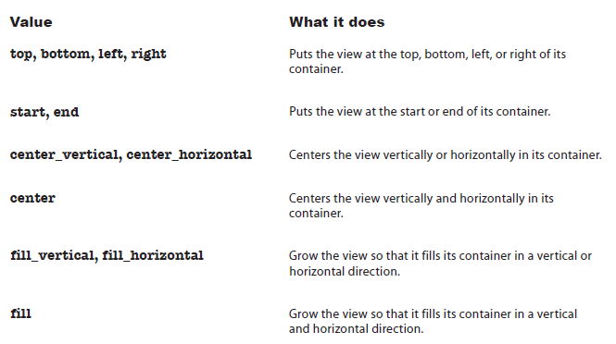
Linear Layout
List of android:layout_gravity attribute

Slide 25
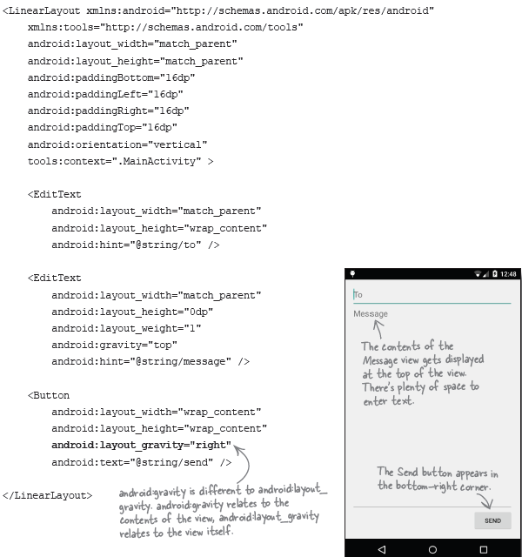
Linear Layout Full Code

Slide 26
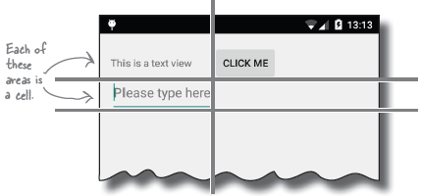
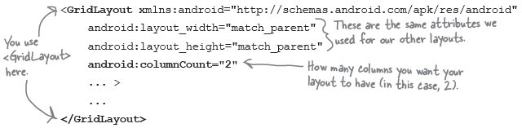
Grid Layout
A grid layout splits the screen up into a grid of rows and columns, and allocates views to cells:
Define a grid layout:
android:columnCount=“number” used to specify how many column
android:rowCount="number" used to specify maximum number of rows

Slide 27
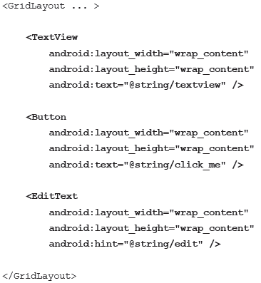
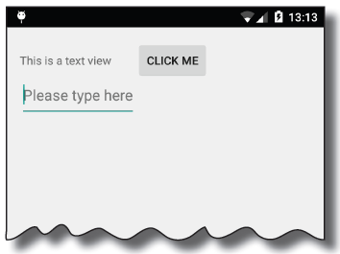
Grid Layout
Adding view to the grid layout

Slide 28
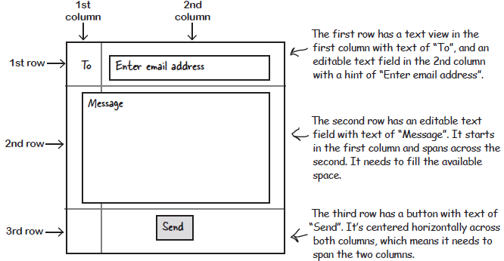
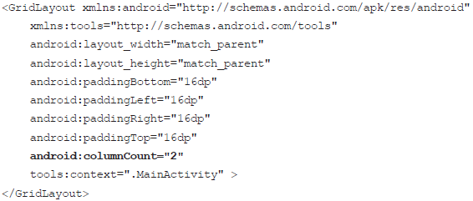
Grid Layout - Example
Start with a sketch
The grid layout needs 2 columns

Slide 29
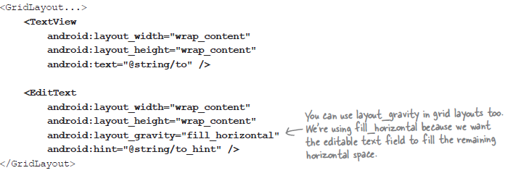

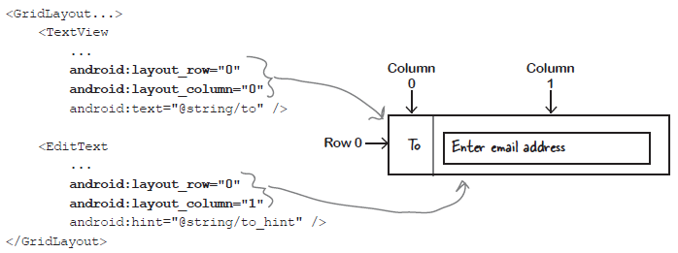
Grid Layout - Example
Row 0: add views to specific rows and columns
Start by adding the views to the layout
use the android:layout_row and android:layout_column attributes to say which row and column you want each view to appear in.

Slide 30
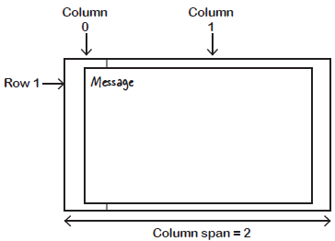
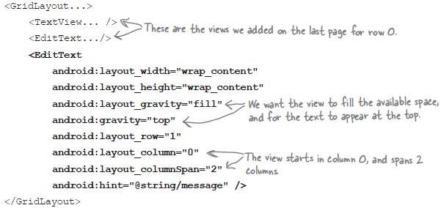
Grid Layout - Example
Row 1: make a view span multiple columns
To get a view to span multiple columns, you start by specifying which row and column you want the view to start in. android:layout_row="1"
android:layout_column="0“
We want our view to go across two columns, and we can do this using the android:layout_columnSpan attribute like this:
android:layout_columnSpan=“2“

Slide 31
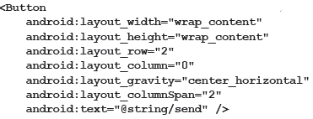
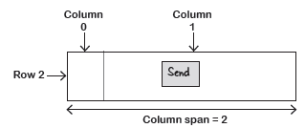
Grid Layout - Example
Row 2: make a view span multiple columns

Slide 32
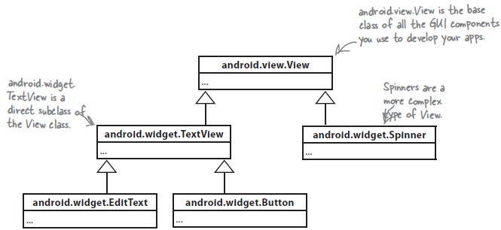
GUI components are a type of View
A GUI component is a type of view, an object which takes up space on the screen.

Slide 33
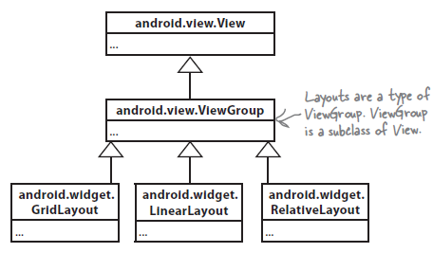
Layouts are a type of View called a ViewGroup
A layout is a type of view group, which is a special type of view that can contain other views.

Slide 34
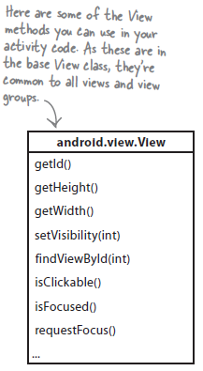
What Being a view buys you
A View object occupies rectangular space on the screen.
Getting and setting properties
  Each view is a Java object behind the scenes, and that means you can get and set its properties in your activity code.
Size and position
  You can specify the width and height of views so that Android
Focus handling
  Android handles how the focus moves depending on what the user does. This includes responding to any views that are hidden, removed, or made visible.
Event handling and listeners
  Each of your views can respond to events. You can also create listeners so that you can react to things happening in the view.

Slide 35
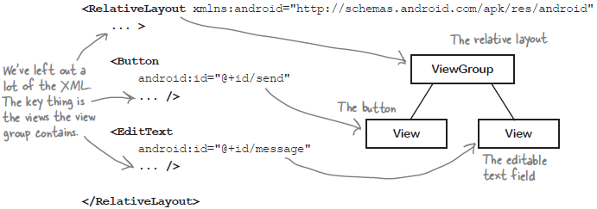
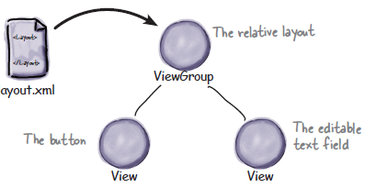
A View Hierarchy
A layout is really a hierarchy of views
Behind the scenes, when you build your app, the layout XML is converted to a ViewGroup object containing a tree of Views.

Slide 36
Example
Aplikasi Band Booking System

Slide 37
Example (Cont.)
Aplikasi Band Booking System

Slide 38
References
Head First Android Development. A Brain friendy guide. Dawn Griffiths and David Griffiths.O’reilly. ISBN:978-1-449-36218-8. Chapter 5

